Slide 1
Data Analysis
Rahul Garg
Date

Slide 2
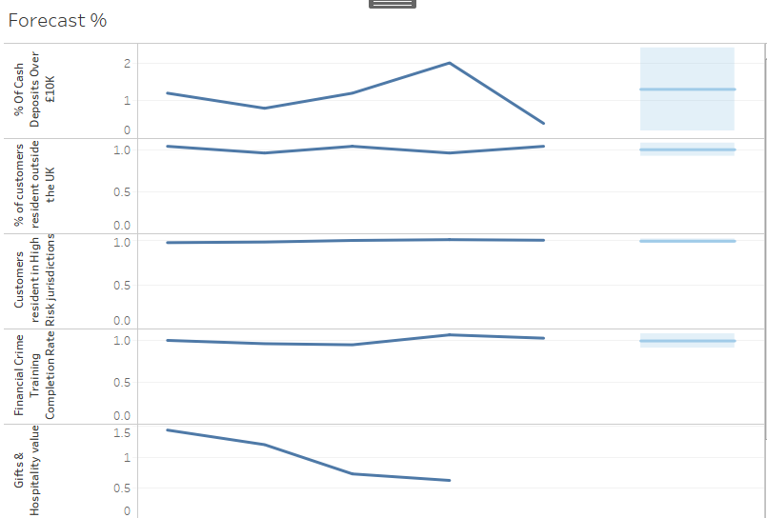
Forecast

Slide 3
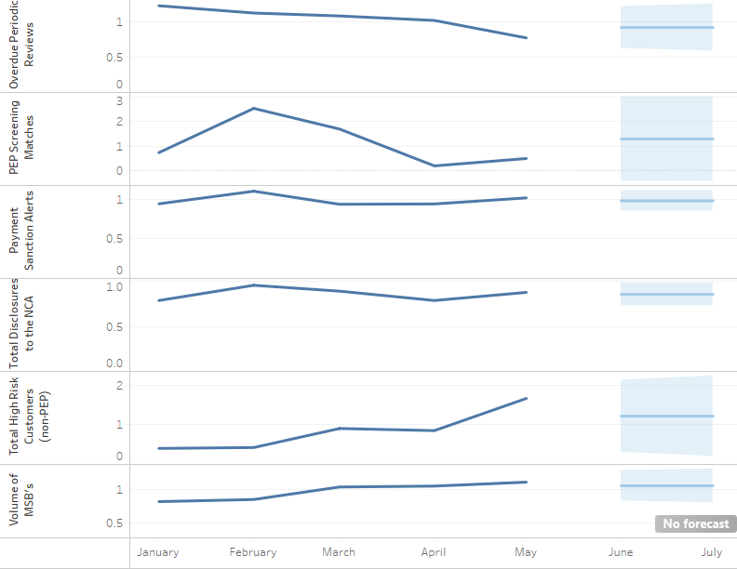
Forecast Continued

Slide 4
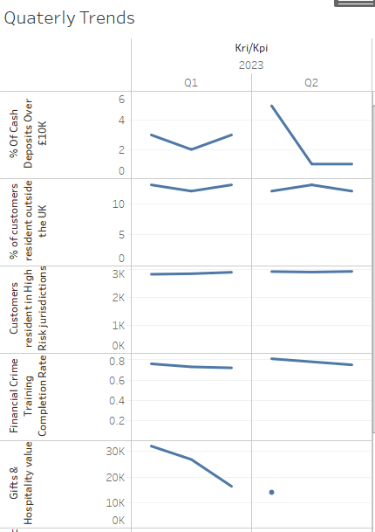
Quarterly Trends

Slide 5
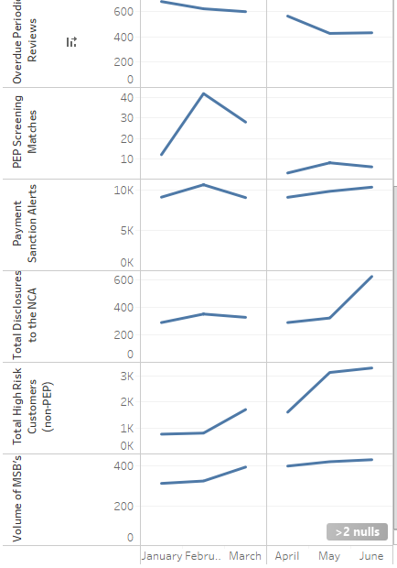
Quarterly Trends Cont..

